Slide 1
IMAGE CAPTIONING
Name: Ami Gandhi
NUID: 001446230
Email: gandhi.am@husky.neu.edu

Slide 2
IMAGE CAPTIONING - INTRODUCTION
Problem Statement:
For a given input image, produce a relevant caption for it.
Approach:
RNN/LSTM is a powerful technique in the field of sequential data modelling
Image captioning is an application of one to many RNN’s.
For a given input image, the model predicts the caption based on the vocabulary of train data.
Deep Learning concepts used are Multi-layered Perceptrons, Convolution Neural Networks, Recurrent Neural Networks, Transfer Learning, Gradient Descent, Backpropagation, Overfitting, Probability, Text Processing

Slide 3
IMAGE CAPTIONING – ABOUT THE DATA
Dataset link: https://www.kaggle.com/shadabhussain/flickr8k
This dataset contains 8000 images each with 5 captions.
After extracting zip files you will find below 2 main input folders -
Images: Contains a total of 8091 images in JPEG format with different shapes and sizes. Of which 6000 are used for training, 1000 for test and 1000 for development.
Flickr_TextData : Contains text files describing train_set ,test_set. Flickr8k.token.txt contains 5 captions for each image i.e. total 40460 captions.

Slide 4
IMAGE CAPTIONING - APPROACH
Load and pre-process the input data
Load weights of pretrained Inception V3 model
Encode the images in train and test set
Create a vocabulary of words whose frequency in the corpus is greater than 10
Determine the maximum length of the caption
Load pre-trained GLOVE word embeddings and generate an embedding matrix of shape (vocab_size, embedding_dimension)
Define LSTM model architecture and train the data in batches
Test and evaluate the model

Slide 5
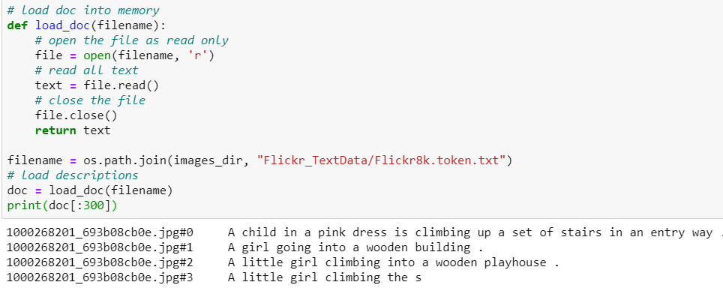
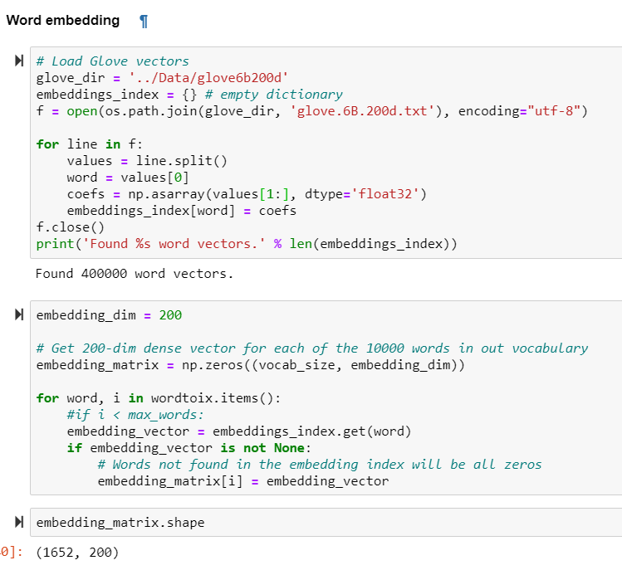
IMAGE CAPTIONING - IMPLEMENTATION

Slide 6
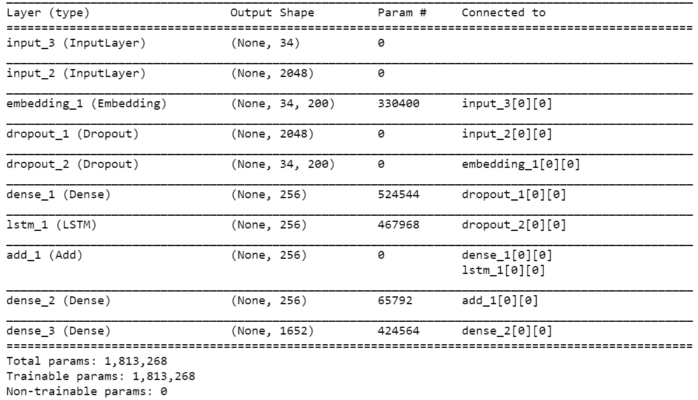
IMAGE CAPTIONING – IMPLEMENTATION

Slide 7
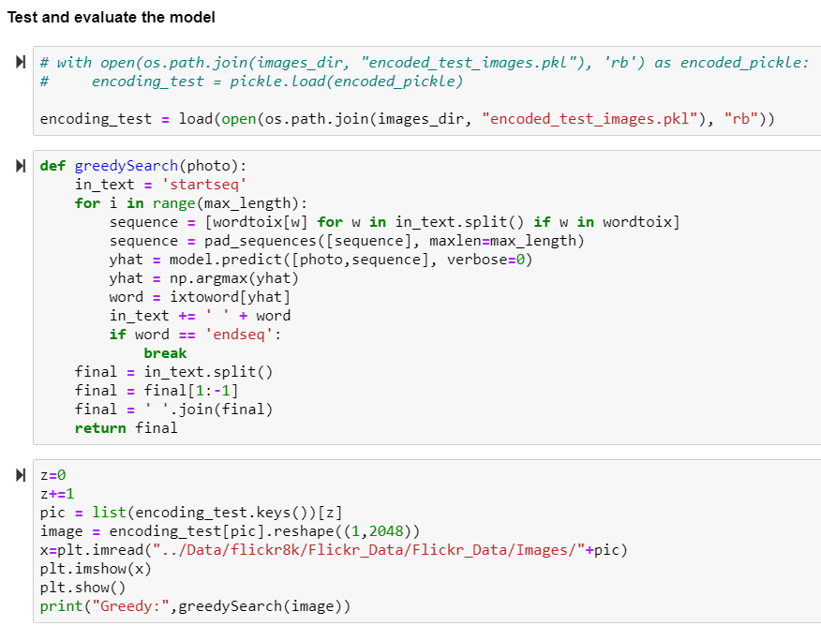
IMAGE CAPTIONING – IMPLEMENTATION

Slide 8
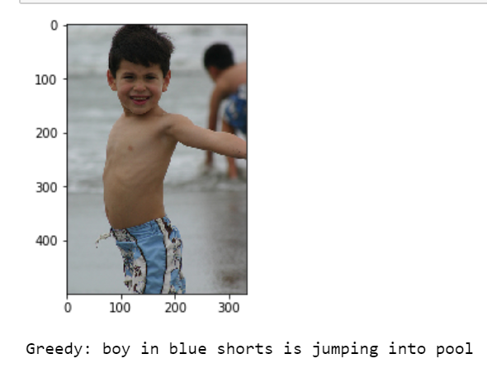
IMAGE CAPTIONING – EVALUATION AND CONCLUSION
For the input image as shown on the right, following caption was generated –
‘boy in blue shorts is jumping into the pool’
Image Captioning was achieved based on trained input images on Inception V3 model, LSTM sequential modelling for just 10 epochs with loss of 2.68

